Slide 1
Harvard and Von Neuman, ARM

Slide 2
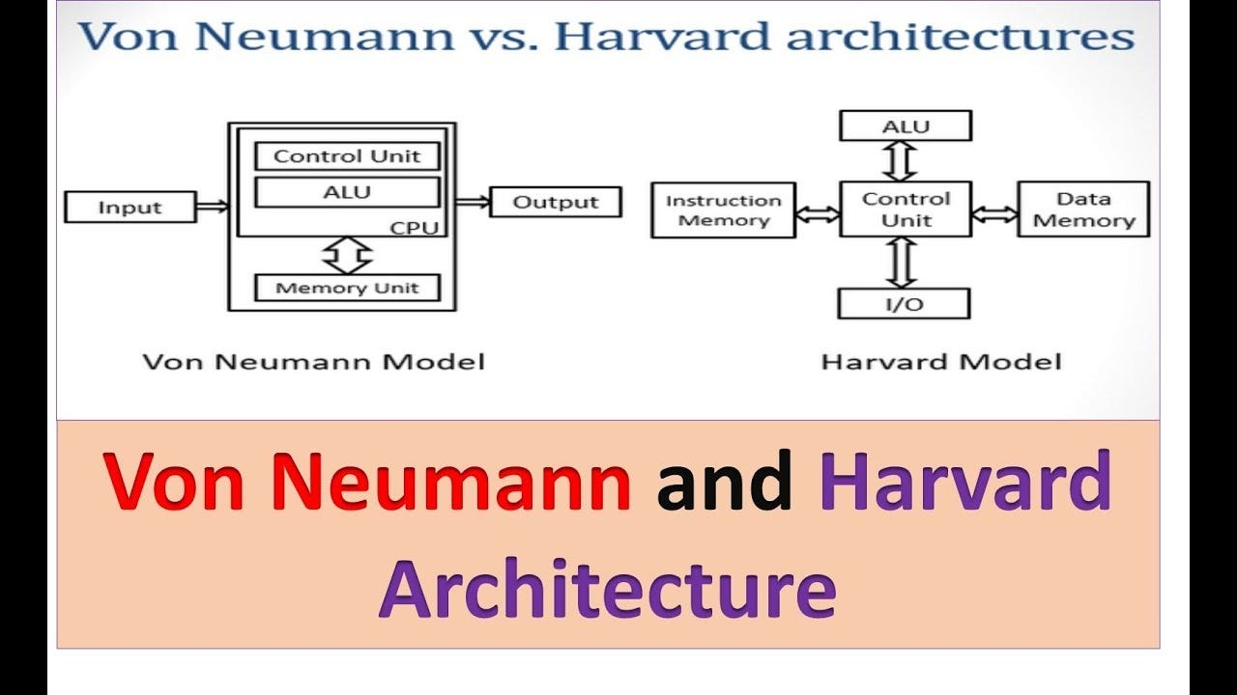

Slide 3
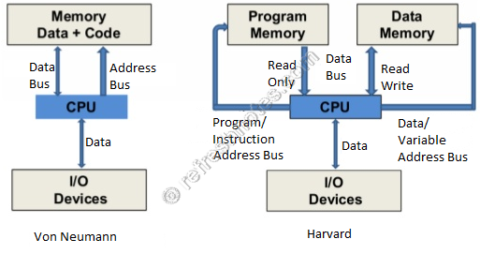

Slide 4
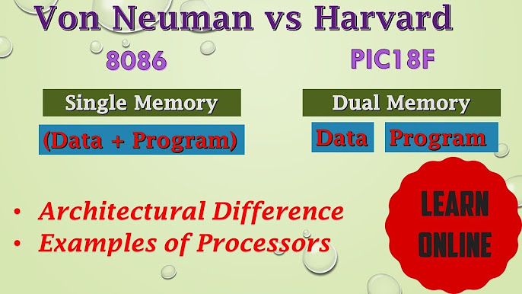

Slide 5
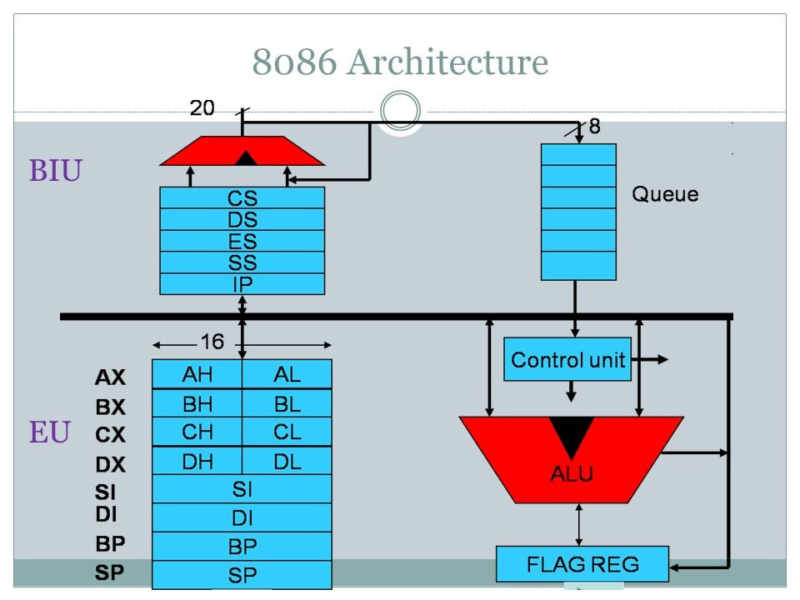
8086

Slide 6

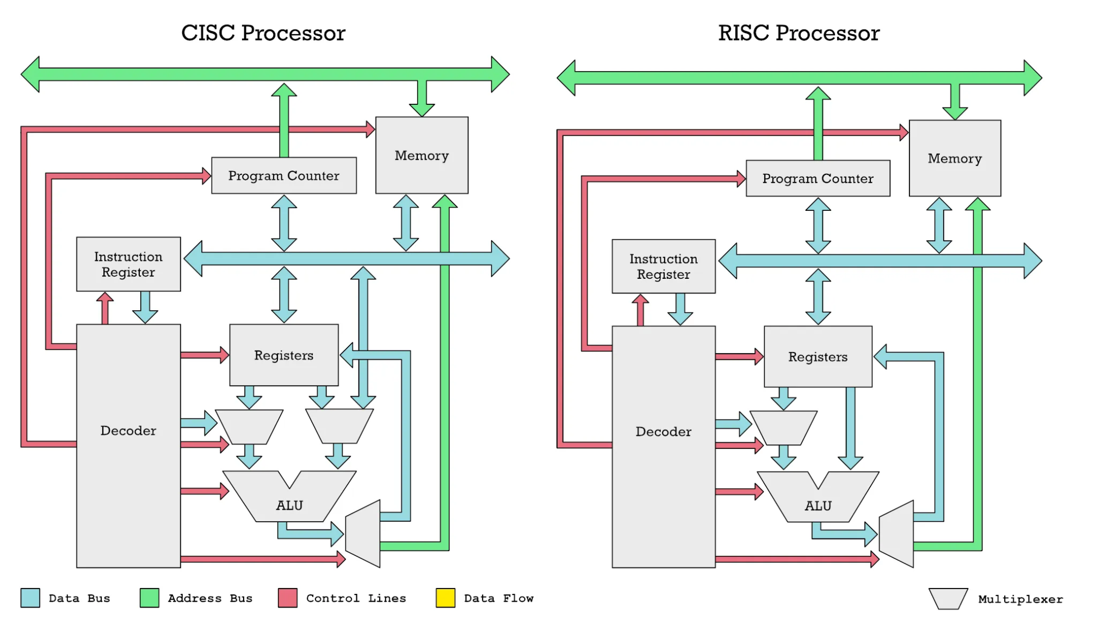
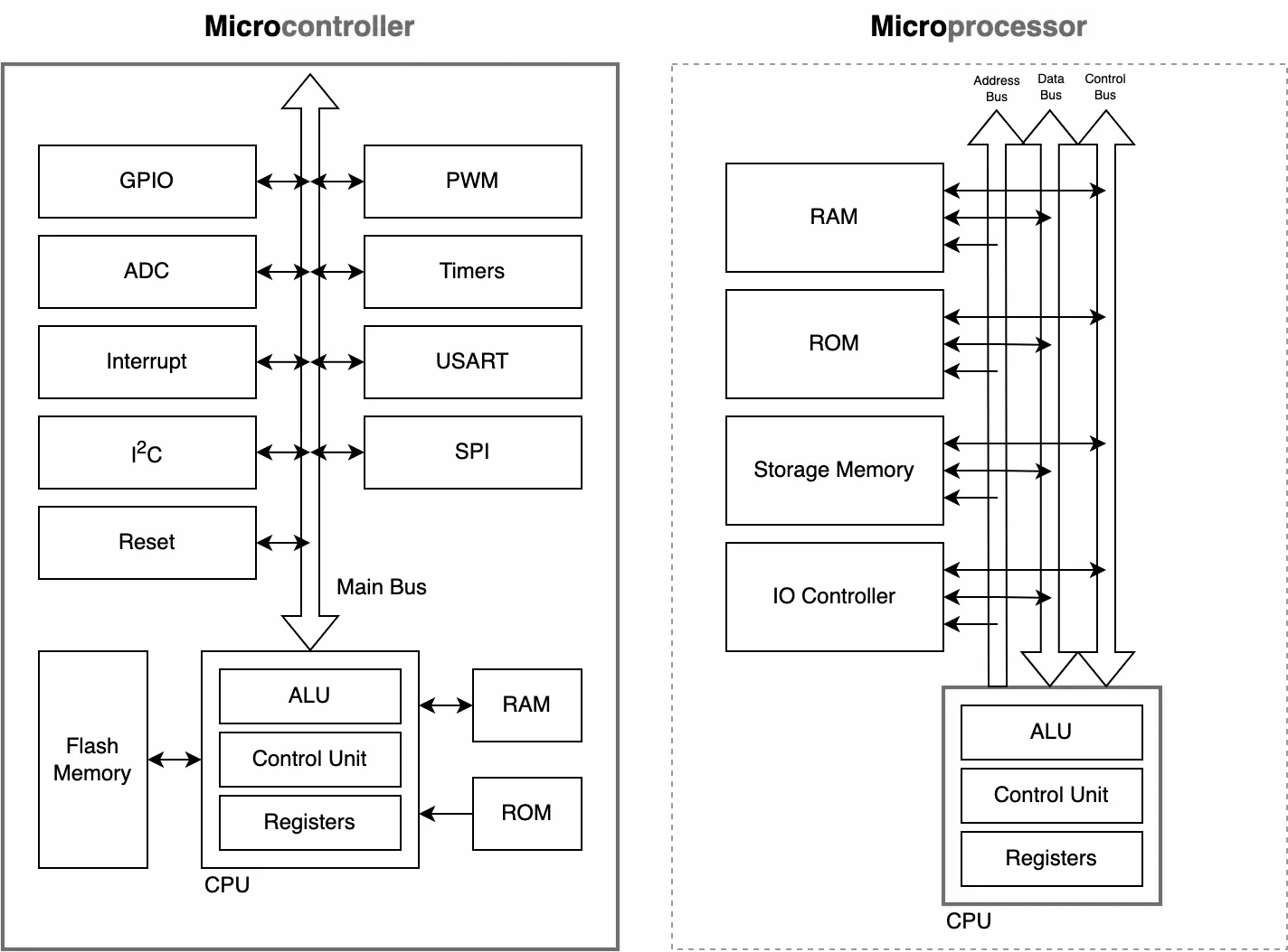

Advantages of ARM Processor over Microprocessors
VS
VS
Figure-Architecture of CISC and RISC processor
Figure-Block diagram of MCU and MPU
Efficiency and Performance
Industry Standard
Availability of Development Tools
Register-Level Programming

Slide 7
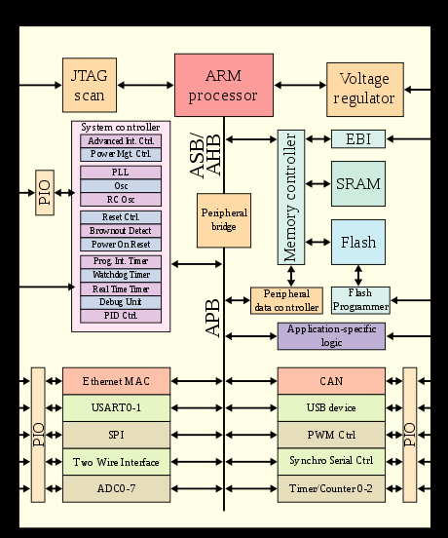
Advanced RISC Machines

Slide 8
ARM processors are also used for desktops and servers,
World's fastest supercomputer (Fugaku) from 2020
Over 230 billion ARM chips produced in 2022

